Slide 1
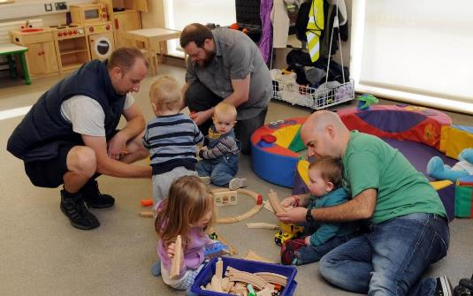
Creating the
Family Hub offer for Solihull
Denise Milnes – Interim Head of Children’s Public Health
Solihull Metropolitan Borough Council

Slide 2

Welcome and introductions
How the webinar will work:
  Presentation on Family Hubs
  Question & answer session
  Guided discussion
Please be aware that the meeting will be recorded
You won’t be able to unmute unless prompted to
If you would like to ask a question, please raise your hand by pressing the hand icon. Alternatively you can write your questions out in the question section on your screen
For the feedback session, please add comments by writing them in the question section on your screen

Slide 3

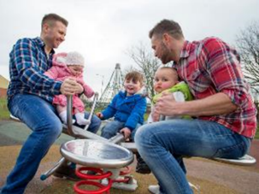
What is a Family Hub Offer?
A family hub offers joined up support services for families with children from before they are born until they are 19 years old (and 25 years for young people with additional needs).
Solihull has been awarded £1m of transformational funding from central Government to create a Family Hub offer by March 2024.
The offer will be….
“a one-stop shop” for advice, appointments, activities and support
a partnership between the Council, NHS and local charities
supporting communities who need it most
part of the early help offer for families - to stop problems getting bigger and more complex

Slide 4

Our Family Hub Vision
We aim to:
build trusting relationships between organisations and families
listen to parents/carers, children and young people to shape the offer
improve family health and mental wellbeing
promote responsive parenting and good early child development
encourage a rich home learning environment and promote school readiness
measure how well the offer is working and change it where needed
make sure that families receive the right help, in the right way, in the right place and at the right time
share information with partners so families only tell their story once.

Slide 5

Family Hub Delivery Plan for Solihull
The Family Hub offer needs to include hub buildings, outreach services and digital services
In Solihull this will be:
  4 Hub buildings –
    operating weekdays, evenings and weekends
    outreach services, where activities take place in the local communities
    Enhanced outreach venues, where part-time services and activities take place in community venues
  Digital offer for the whole borough(e.g.website, online groups, advice, App)

Slide 6




Start for Life services we have to have in the hub offer:
Maternity services
Health visiting
Infant feeding support
Parent mental health
Infant mental health (parent-baby attachment)
Special educational needs and disabilities
Safeguarding

Slide 7
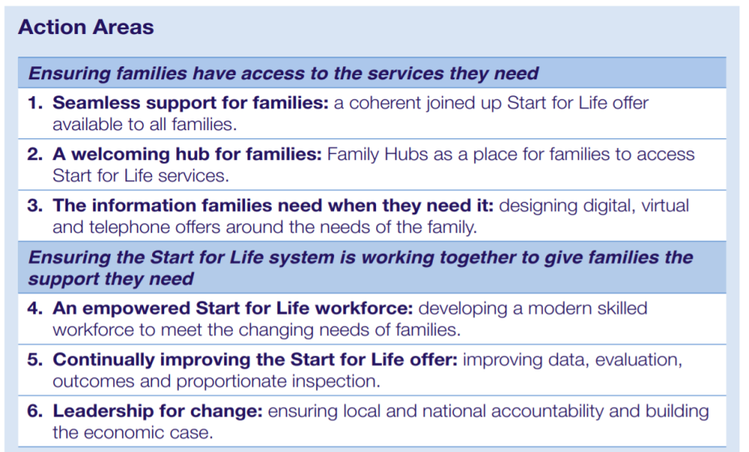
The Best Start for Life: A vision for the first 1,001 critical days (Leadsom Review,2021)

Slide 8
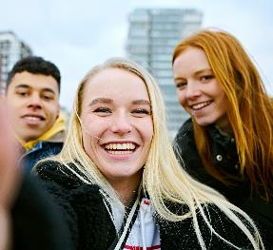
Health Services:
Maternity appointments
Health visitor sessions/clinics
School nursing sessions/advice
Appointments for community health services (e.g. Occupational therapy, physiotherapy)
Mental health support/advice
Immunisation sessions
Family weight management support
Addiction services – smoking, drugs and alcohol
Sexual health services/outreach
Breastfeeding cafes
Learning disabilities nurse support
Condition specific support e.g diabetes, ADHD
Oral health advice
Advice on illnesses/link to local doctors
The Family Hub offer could include:
Parenting and child development:
Family Support
Parenting courses/advice
Child development sessions
Story time sessions/book exchange
Support with parental conflict
Support for separating and separated parents/carers
Support for foster carers

Slide 9

Social sessions/drop-ins:
coffee mornings/crafting/youth clubs
Peer support e.g. LGBTQ+ parent groups, dads groups, adolescent parents
Stay and play sessions
Special educational needs and disabilities support groups/advice
Seasonal activities – Christmas, Halloween etc.
Wider support/advice:
Financial/debt advice
Benefits advice
Housing support/advice
Domestic abuse support
Youth work/support
Youth justice
…….and more……
Education and employment support:
Links to local schools – sessions in hubs and schools
Adult education sessions
Community/family learning sessions
Employment support/training

Slide 10

“At its best, this model provides a ‘local nerve centre’ for all family support within a community, bringing together everything from stay and play groups, to breastfeeding support, to help with issues such as finding a job or applying for benefits.”
Barnardo’s (2021) It takes a village: the case for family support in every community

Slide 11
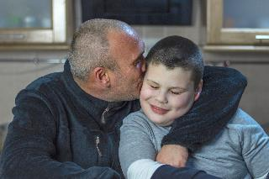

Hub buildings
Principles:
Warm, welcoming, accessible, attractive and safe
Drop-in for advice/support/use facilities (space to feed/change/access to the sensory room/youth space)
Multi-use space – make the most of the available space
Activities/sessions run alongside clinics/ advice sessions/ peer group support
A space where all families feel it’s a place for them

Slide 12
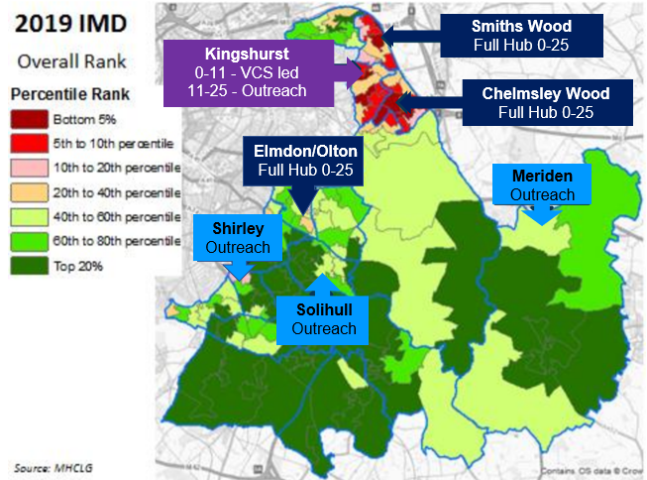
Priority Location Criteria
Areas of higher need based on data and information on local inequalities
Accessible - on good public transport routes, close to amenities where families already go

Slide 13
MINIMUM SPEC FOR A HUB |  | Est. no. of people | Further information
Bookable room for clinical work | 1 | 2-5 | Sink, examination bed, clinical flooring etc
Bookable room for contact & 1:1 direct work | 1- 2 | 2-4 | Can be used as a breastfeeding/calm space when not booked
Large room | 1 | 16 adults & 22 children | Group activities/training/ play sessions
Medium room – multi-use but focus on young people (11-25) | 1 | 15 | Group activities/small group work drop-in social space
Reception space | 1 | 2-3 | Clothes, toys and books on offer
Office space | 1 | 4-6 | For council, NHS and charities to use
Kitchen | 1 | 4-8 | Food preparation & cookery sessions
Digital pods | 1 | 1-2 | Can be sited in large room if required
Toilets (inc. accessible toilets) | 2-4 |  | With nappy changing facilities
Sensory room | 1 | 4-6 | Specified for this to be multi-use/all age – calming & stimulating due to need

Slide 14

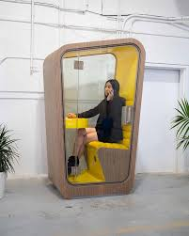
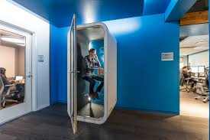
Digital offer within the hubs could include:
Pods with laptops and privacy for parents/carers/ young people to access virtual appointments (such as health or housing support etc.)
Online courses e.g. parenting courses with/without social sessions
Laptops/tablets to access online group sessions, such as parenting groups/school readiness sessions/parent information sessions/ training
Access to online advice/support counselling (such as Kooth counselling)
Tablets with access to child development/education activities

Slide 15

Other features a Family Hub offer could include:
Office space for different teams/organisations
Hot desking for partner services
Training – rolling programme of training incorporating:
  child development
  mental health
  preventing illnesses
  family support etc.
Parent volunteer training:
  General – covering peer support groups for example
  Parent group leader training (for ‘being a parent’ course)
  Dads-specific activity
Work placements/paid internships for adults with learning disabilities
Link to local schools and teams for education/ inclusion

Slide 16
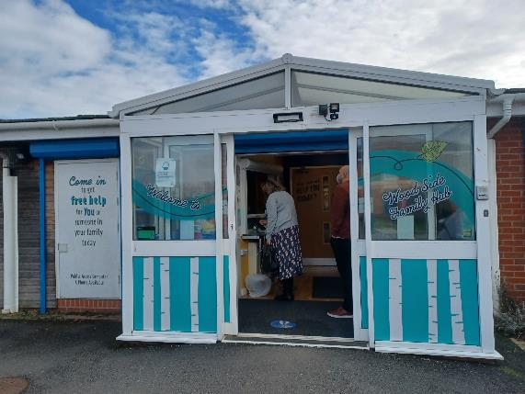
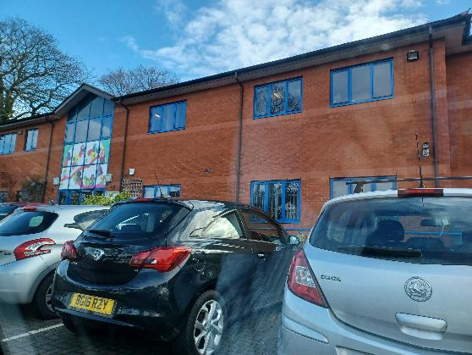
Coventry Family Hubs – best practice

Slide 17
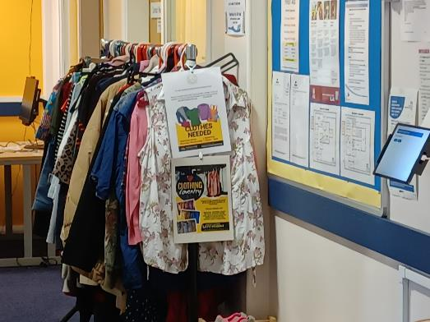
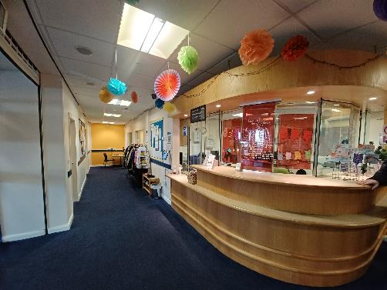
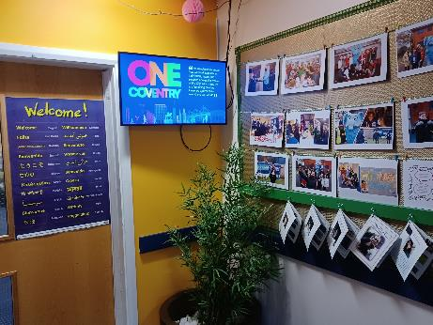
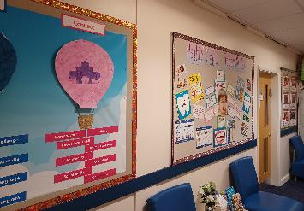
Reception – a warm welcome

Slide 18
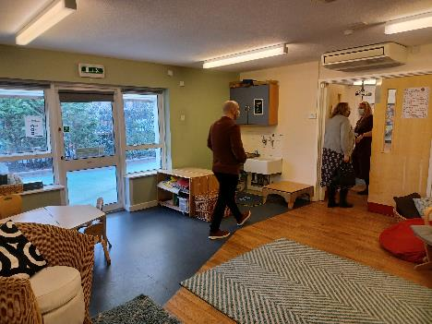
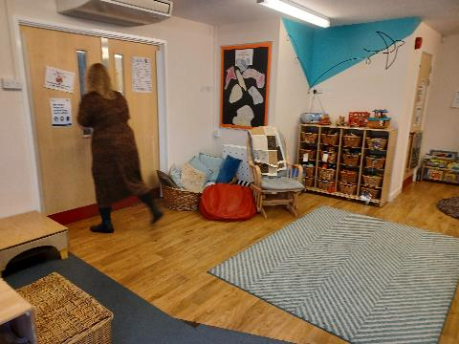
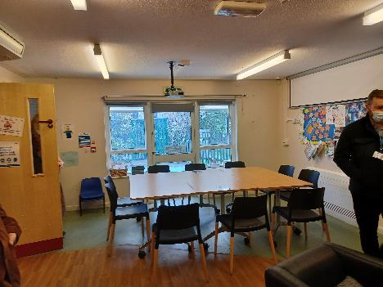
Large room with multi-use space

Slide 19
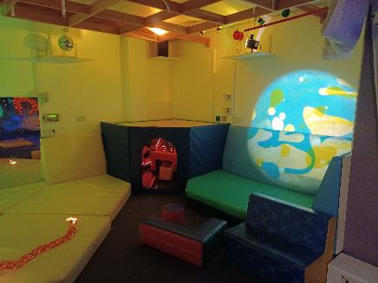
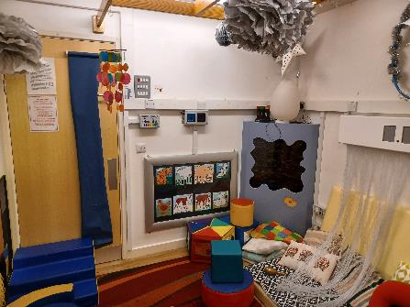
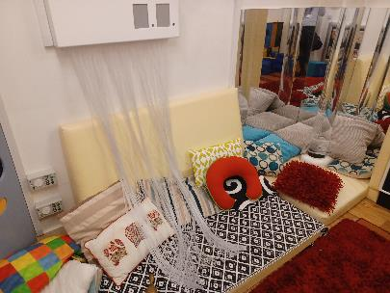
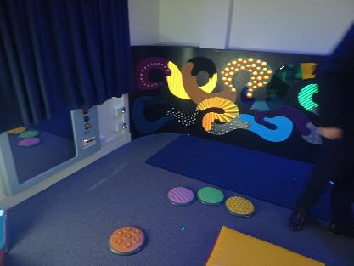
Sensory Rooms

Slide 20
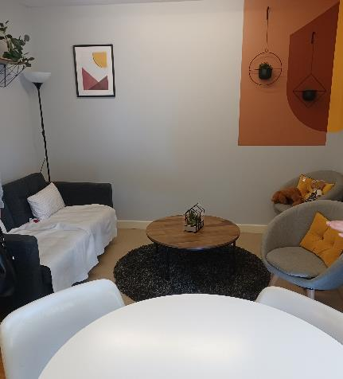
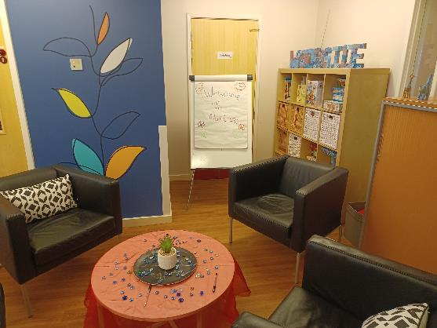
Comfortable spaces for 1:1 and small group work and socialising

Slide 21
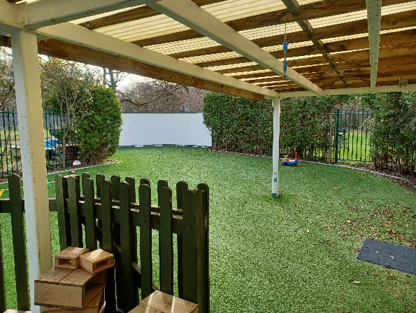
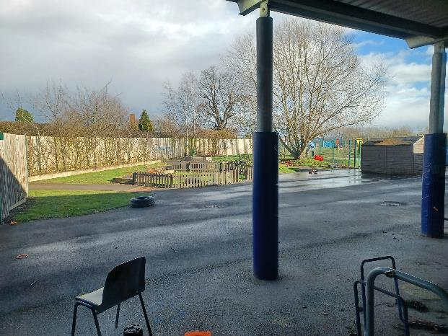
Outside space –
not essential but desirable

Slide 22
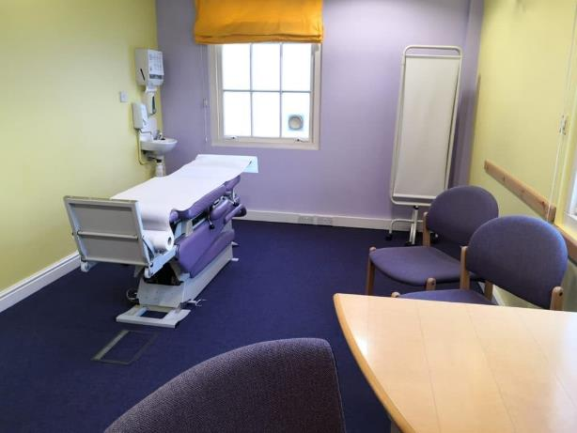
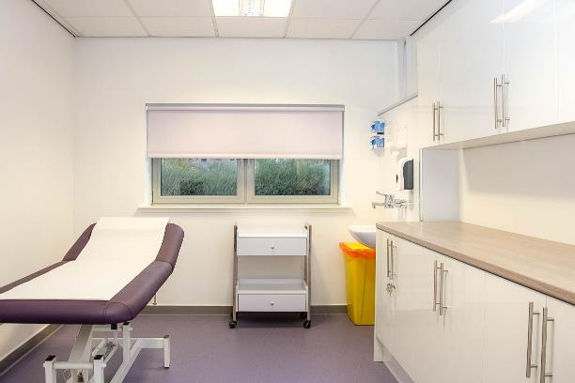
Clinical rooms –
to be multi-use
Examples – not Coventry

Slide 23
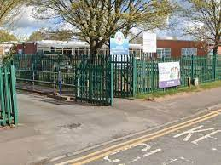
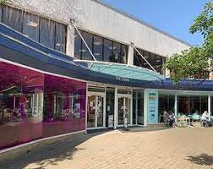
Enhanced Outreach Venues
Consistent, part-time hub presence – e.g. pop-up sessions run from a community venue every weekday morning or afternoon
Delivery of services/activities
Centres will display Family Hub branding
Possibility of mobile units with toys, books, space for 1:1 work
Proposed locations for Outreach Plus:
Meriden – primary school site and park
Solihull – The Core, community centres, church halls
Shirley – community centres, church halls

Slide 24

Digital Offer to include:
Online appointments/advice
Online groups
Website
Link to Family Information Service and Five to Thrive websites
Live chat/ real-time support (tbc)
Links to text messaging support already in place e.g. Chat Health
Social media messages
App for time-related messaging (push notifications – links to booking)
Online booking/links to NHS booking
Signposting…& more

Slide 25

Links to Schools:
Schools will be able to directly signpost to Family Hub activity and promote this with their school community
School websites can link to the Family Hub website/booking system
Schools can promote information sessions such as school readiness, family support
Schools are leading partners in the hub offer
Hub outreach sessions on school sites

Slide 26

Parent Carer Panel
Families are valued partners in designing the hub offer – not recipients.
We are looking for parents/carers to help shape services locally and specifically feed into the development of our new Family Hub offer.
You don’t need any formal qualifications, just come with a willingness to talk about your own experience and ideas.
What will I do as a panel member?
Share your perspective as a parent/carer at meetings or via polls
Help us to test and review our services and give us your feedback
Review our resources and let us know what we can improve

Slide 27
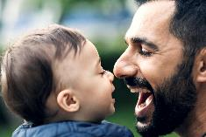
Parent Carer Panel (cont)
How much time will it take?
Joining the online panel (using Microsoft Teams) will likely need about 1.5 hours every 2 months, including meetings and feedback. You can choose to join or drop out at any time.
What will I get out of taking part?
We want being part of the panel to be an enjoyable and rewarding experience and for members to see the impact of their contributions. You will get to meet other parents/carers who want to help remove the barriers that people face and shape services.
Interested? Please email your contact details to familyhubs@solihull.gov.uk

Slide 28
Next steps – engaging partners and families
Public survey
Focus groups
Parent Carer Panel
Continuing planning the hub buildings
Development of the digital offer
Consideration of a mobile unit
Continue working with the NHS and charities on their services in the hubs
Family Hub webpage on the Solihull Council website with updates

Slide 29

Any questions?
“It is easier to build strong children than to repair broken men”
Frederick Douglass (1855) Social Reformer, Abolitionist and Statesman
“Investing in this period [very early childhood] is one of the most efficient and effective ways to help eliminate extreme poverty and inequality, boost shared prosperity, and create the human capital needed for economies to diversify and grow.”
Unicef, World Bank and WHO Nurturing Care Framework
familyhubs@solihull.gov.uk

Slide 30
Feedback
What are your thoughts on the Family Hub offer in Solihull?
Are there additional activities/services you would like to see in the Family Hub offer?

Slide 31
Feedback (cont)
How likely are you and your family(or the people you work with) to visit a Family Hub?
If not, what would make you more likely to visit a Family Hub?

Slide 32
Feedback (cont)
Are there any particular social/group activities you would like to see in the hub?
Do you have any further comments?

Slide 33

Thank you for attending
Further thoughts/queries – please email familyhubs@solihull.gov.uk

